Slide 1
Weather trend prediction and forecasting based on time-series model and deep neural network
Presented by: Muhan Hu, Han Weng, Fangrui Zhu
ECE657A Data and Knowledge Modeling and Analysis (Winter 2019)

Slide 2
Outline
Part I. Target and data cleaning
Part II. Weather trend prediction
Part III. Weather forecasting

Slide 3
Part I. Target and data cleaning
Dataset
Goal
Spark/Hadoop data pre-processing

Slide 4
Data collection
Raw Data:
37 cities: Canada, United States, Israel
6 years: 2012-2017
Hourly data
Temperature, humidity, pressure, wind direction, wind speed
~9 million data points
Goal
Weather trend (each feature) prediction – time-series regression
Weather forecasting - classification

Slide 5
Get data ready
Temperature
Wind direction
Wind speed
Humidity
Pressure

Slide 6
Get data ready

Slide 7
Get data ready

Slide 8

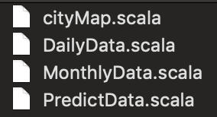
Get data ready
Aggregated daily data for a given feature in a given city
Aggregated monthly data for a given feature in a given city
Spark Engine
(distributed, map-reduce)
...
Filtering, aggregation
Collected hourly feature set and weather labels for a given city

Slide 9
Part II. Weather trend prediction
Sample stationarity check
Time-series Modeling: AR, MA, ARIMA
Trend prediction

Slide 10
Data stationarity – Original data
Original monthly temperature data for Toronto

Slide 11
Data stationarity – Improve

Slide 12
Data stationarity – Improve
Original
Trend
Differencing: remove trend (general)
Residual
Seasonal
Rolling window: w=12

Slide 13
Data stationarity – Result check
Results of Dickey Fuller Test | Original | Log Scale Transformation | Time Shift Transformation
Test Statistic | -0.800512 | -1.254808 | -8.879796e+00
p-value | 0.818972 | 0.649586 | 1.327455e-14
#Lags Used | 10.000000 | 10.000000 | 9.000000e+00
Number of Observations Used | 51.000000 | 40.000000 | 5.100000e+01
Critical Value (1%) | -3.565624 | -3.605565 | -3.565624e+00
Critical Value (5%) | -2.920142 | -2.937069 | -2.920142e+0
Critical Value (10%) | -2.598015 | -2.606986 | -2.598015e+00

Slide 14
Data stationarity – Result check
Results of Dickey Fuller Test | Original | Log Scale Transformation | Time Shift Transformation
Test Statistic | -0.800512 | -1.254808 | -8.879796e+00
p-value | 0.818972 | 0.649586 | 1.327455e-14
#Lags Used | 10.000000 | 10.000000 | 9.000000e+00
Number of Observations Used | 51.000000 | 40.000000 | 5.100000e+01
Critical Value (1%) | -3.565624 | -3.605565 | -3.565624e+00
Critical Value (5%) | -2.920142 | -2.937069 | -2.920142e+0
Critical Value (10%) | -2.598015 | -2.606986 | -2.598015e+00

Slide 15
Data stationarity – Result check
Results of Dickey Fuller Test | Original
Test Statistic | -3.298062
p-value | 0.014965
#Lags Used | 11.000000
Number of Observations Used | 38.000000
Critical Value (1%) | -3.615509
Critical Value (5%) | -2.941262
Critical Value (10%) | -2.609200

Slide 16
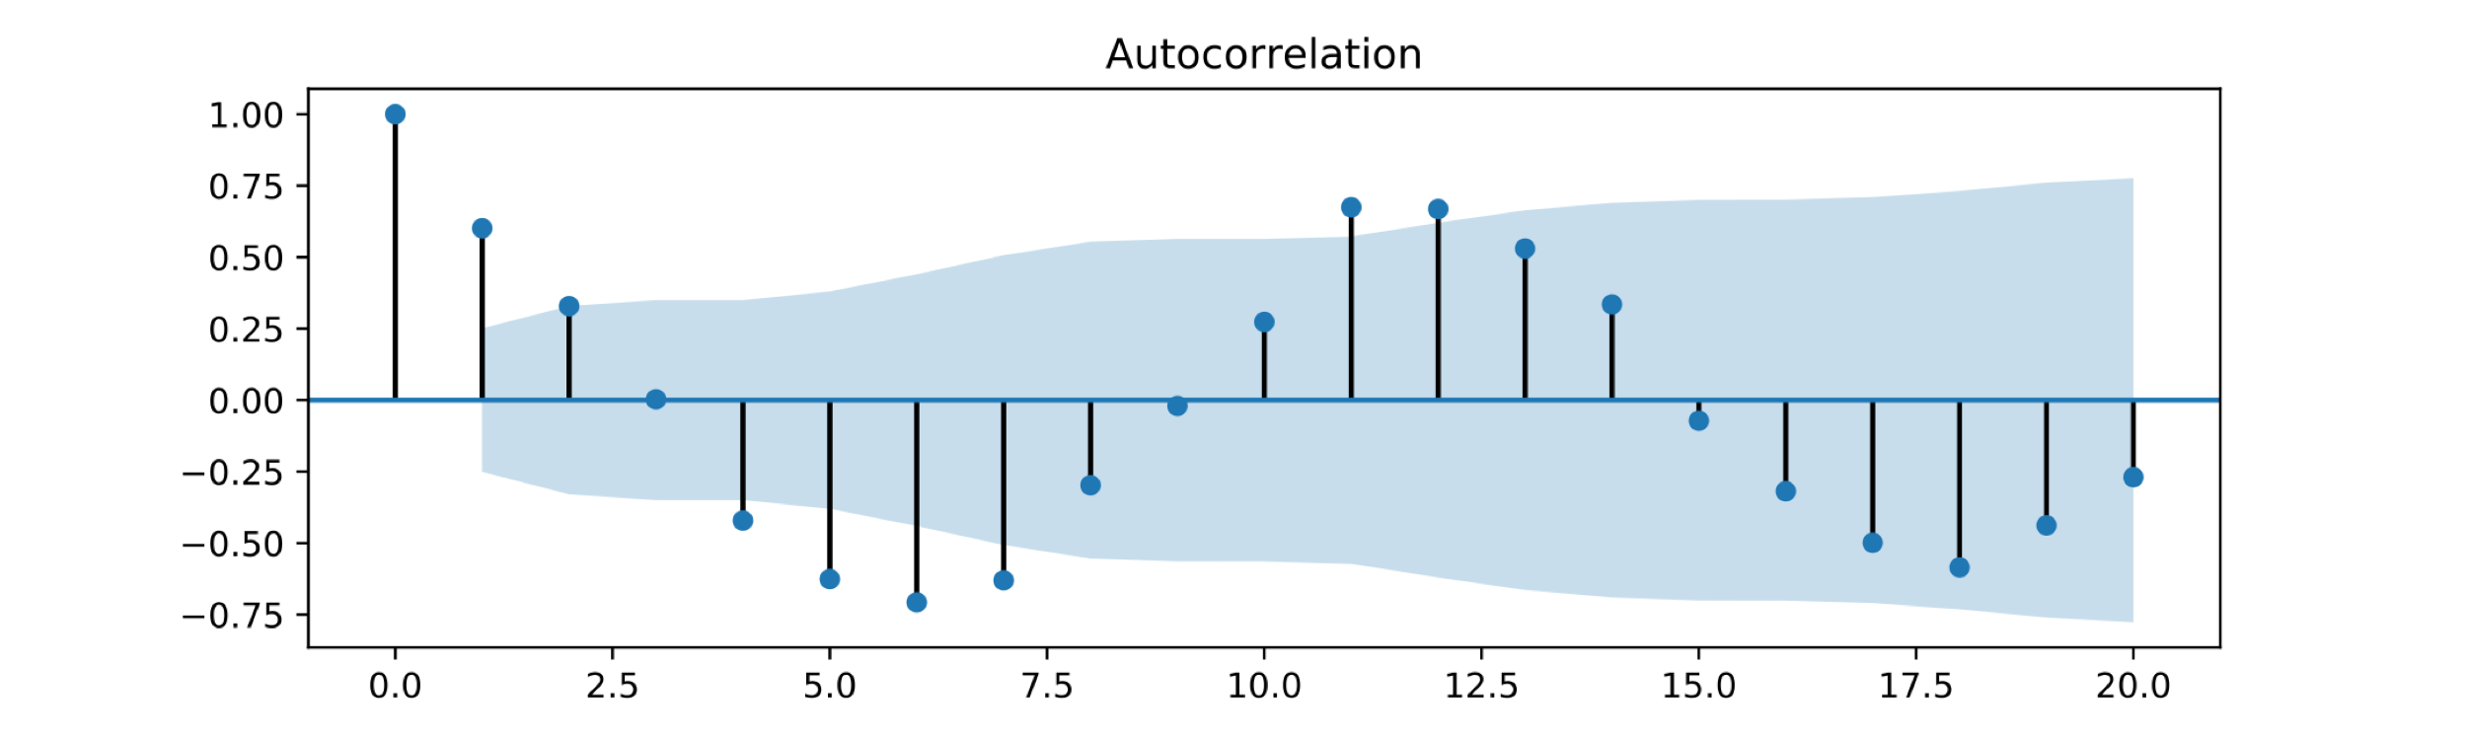
Modelling – finding p, q value
ACF is geometric

Slide 17
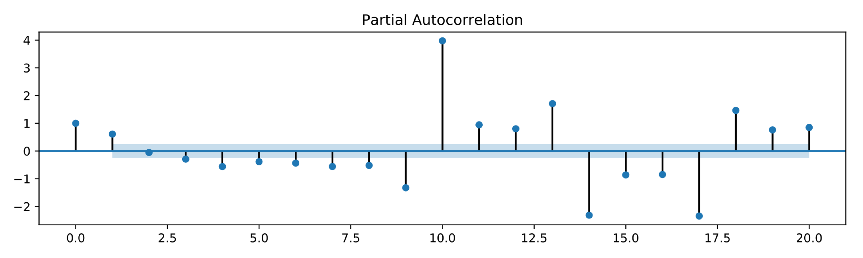
Modelling – finding p, q value
ACF is geometric
Significant in the
first and second lags

Slide 18
Models
AR Model: consider p, d
MA Model: consider q, d
ARIMA: consider p, q and d

Slide 19
Models

Slide 20
Models

Slide 21
Models

Slide 22
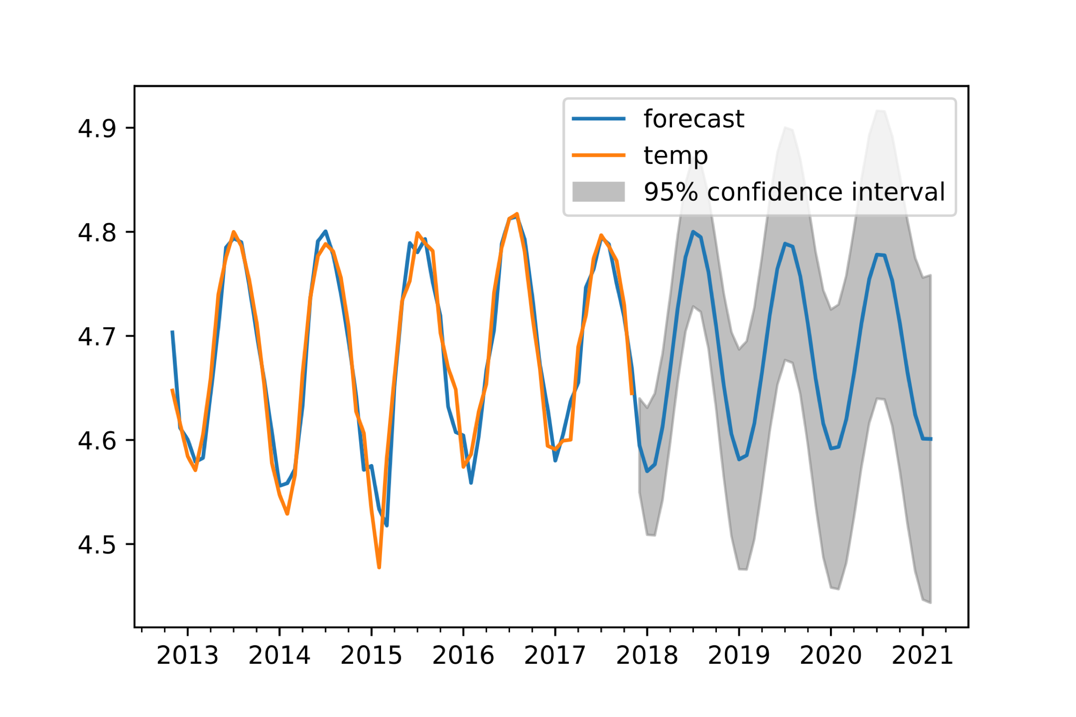
Prediction results
Date | Actual Data | Predicted Data
2017-07-01 | 21.106953 | 22.404260
2017-08-01 | 19.825096 | 21.353791
2017-09-01 | 18.181847 | 17.158485
2017-1o-01 | 13.234041 | 11.012681
2017-11-01 | 4.049218 | 4.471090
Temperature prediction (after log transformation)
Comparison between real and predicted data
(recovered to Celsius)

Slide 23
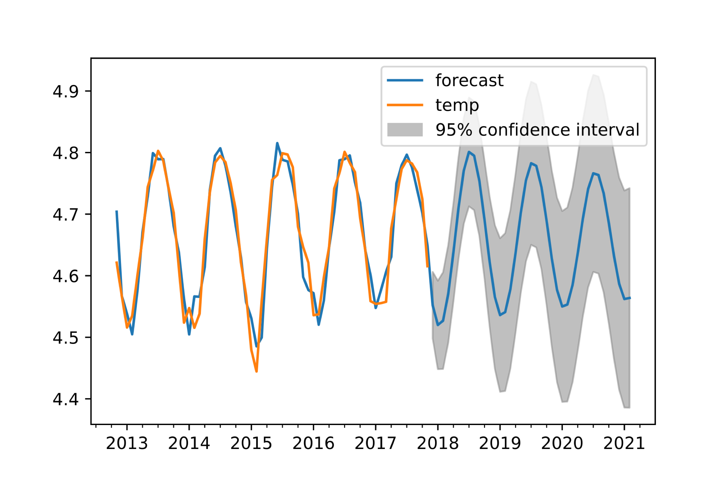
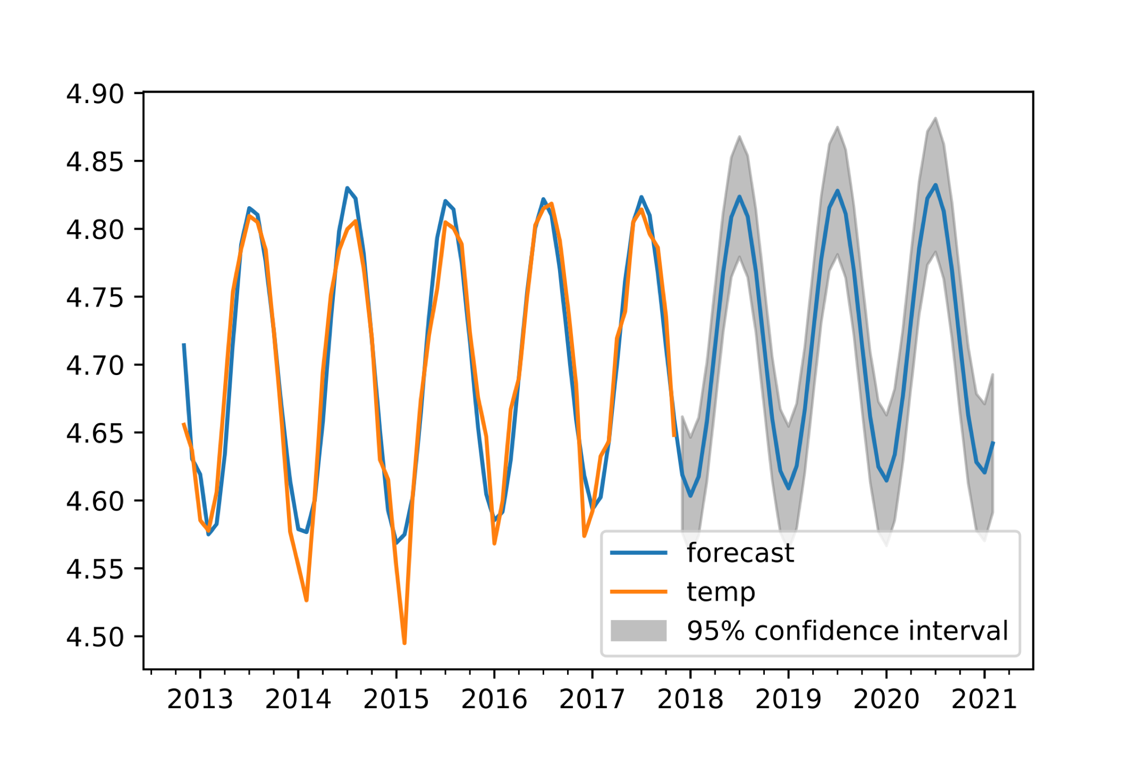
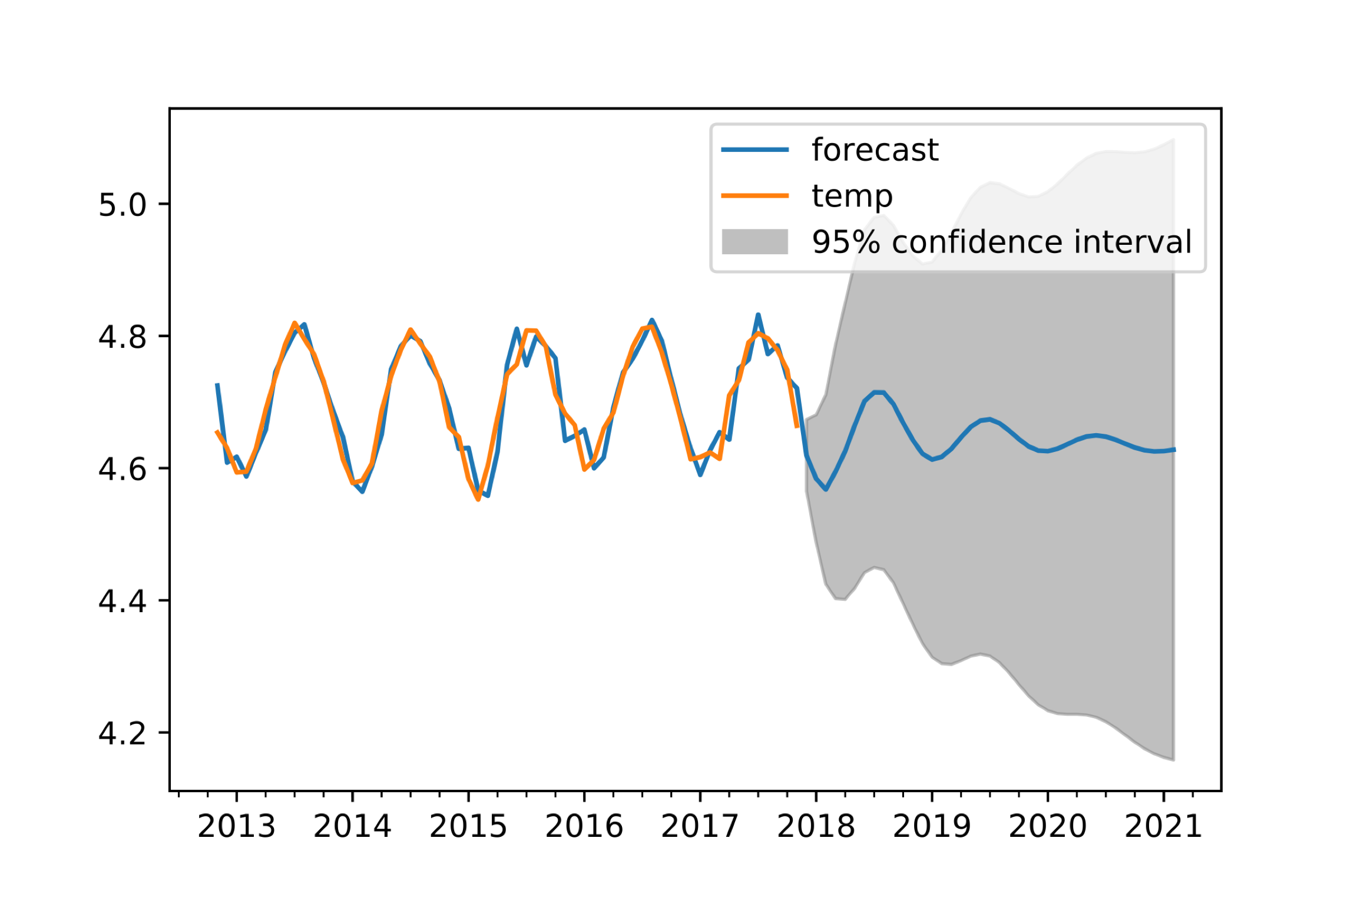
Prediction results for more cities
Montreal
Chicago
Boston
Prediction for other features (pressure, humidity, etc) and other cities also performed (not shown here)

Slide 24
Part III. Weather forecasting
Model training: DNN, Keras (TensorFlow backend)
Result evaluation

Slide 25
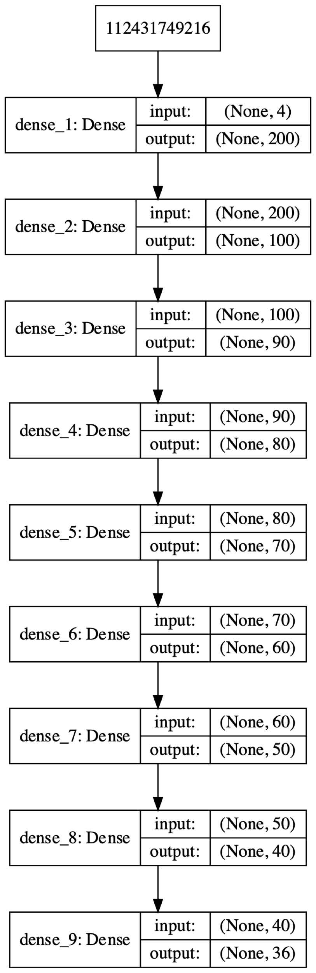
DNN model
Sigmoid
Linear
ReLU
Linear
ReLU
ReLU
Linear
Sigmoid
Softmax

Slide 26
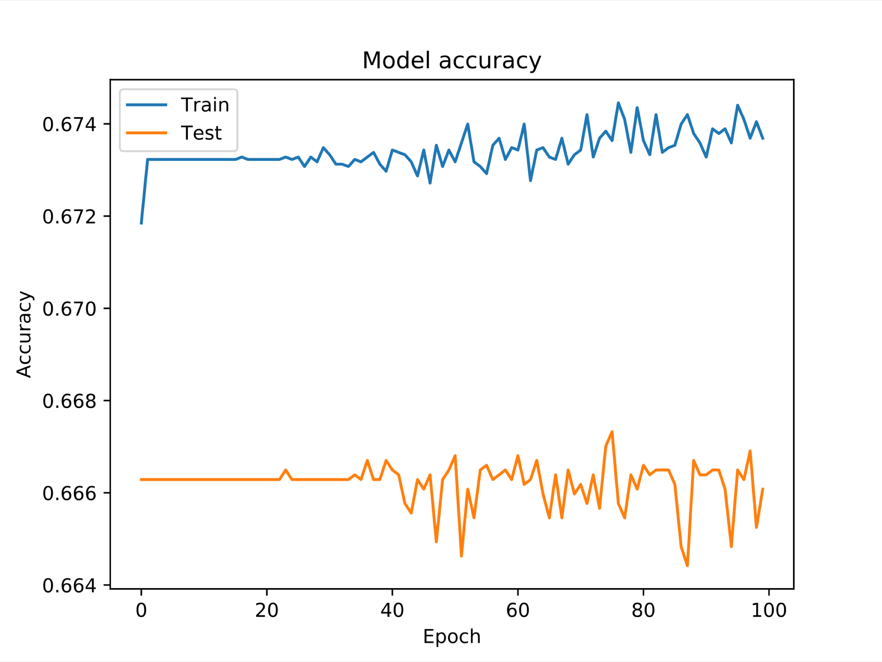
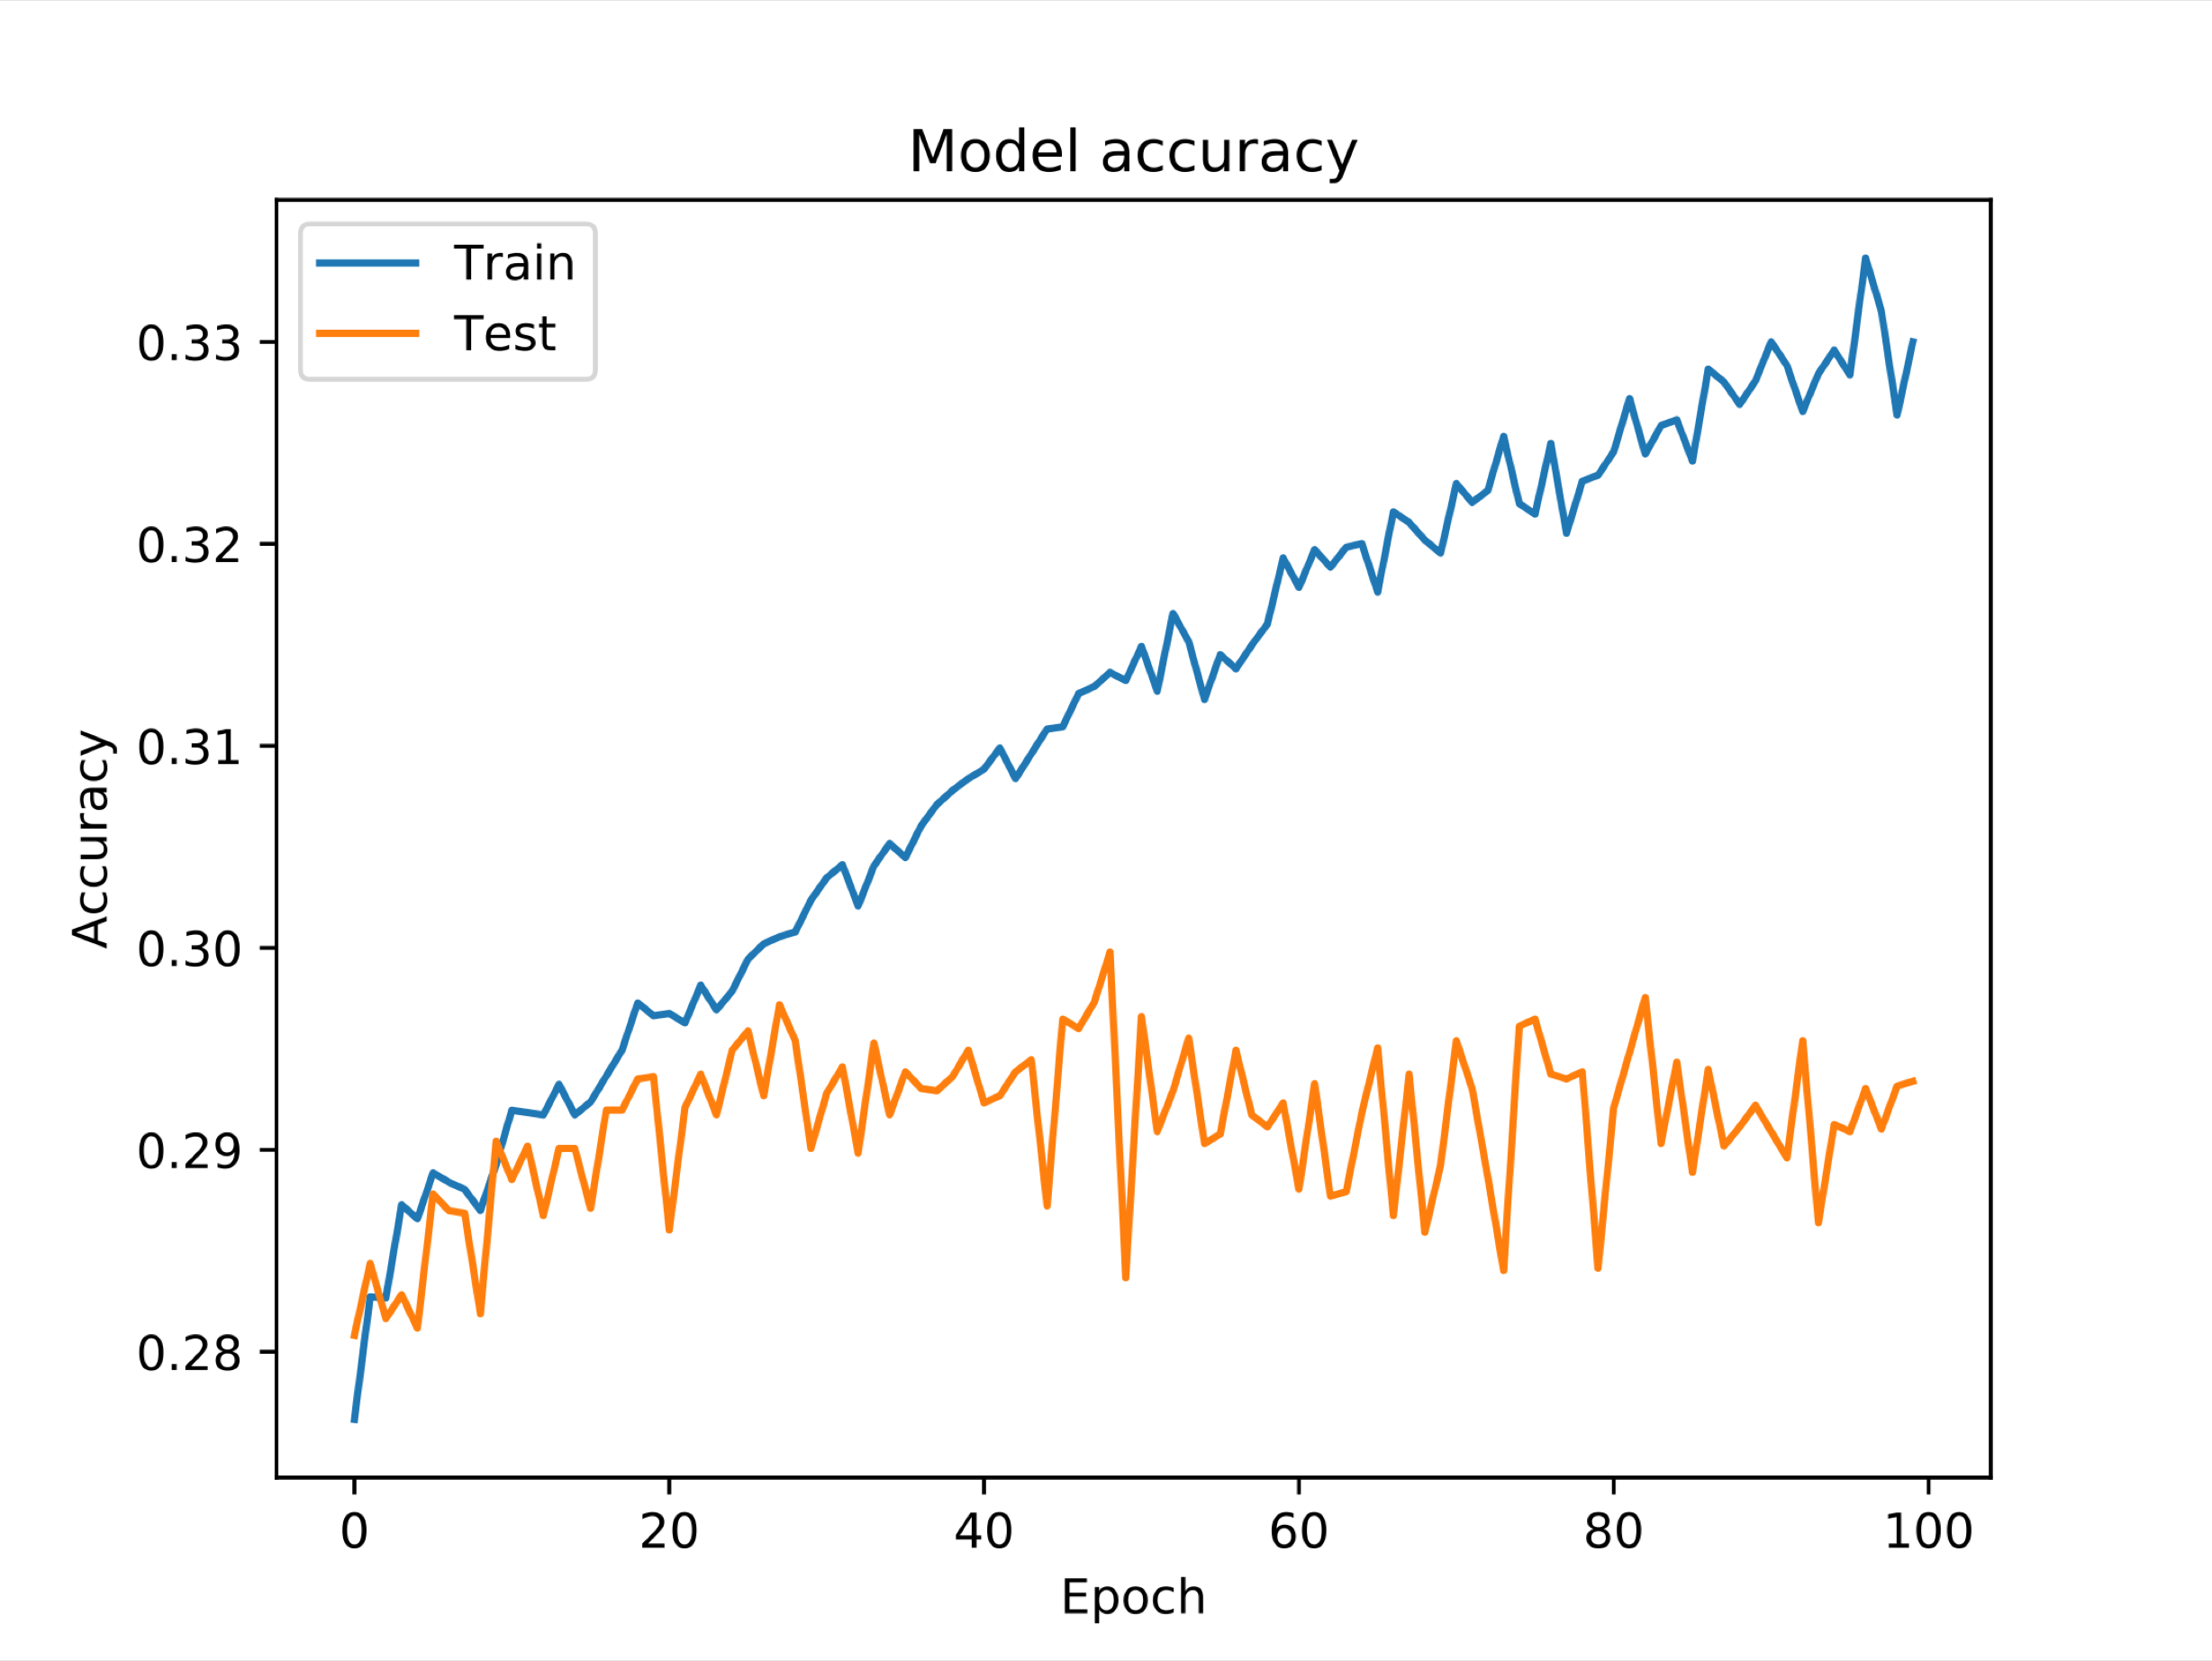
Original results (detailed labels with 35 classes)
Classification accuracy in Phoenix and Vancouver (highest and lowest among all cities, respectively)

Slide 27
Accuracy improvement: reduce class numbers
broken clouds
few clouds
clouds
35 classes
13 classes
Again!

Slide 28
Accuracy improvement
Phoenix: no obvious change
Vancouver: 7.94% increase
Toronto: 12.14% increase
Portland: 15.45% increase
Seattle: 8.4% increase

Slide 29
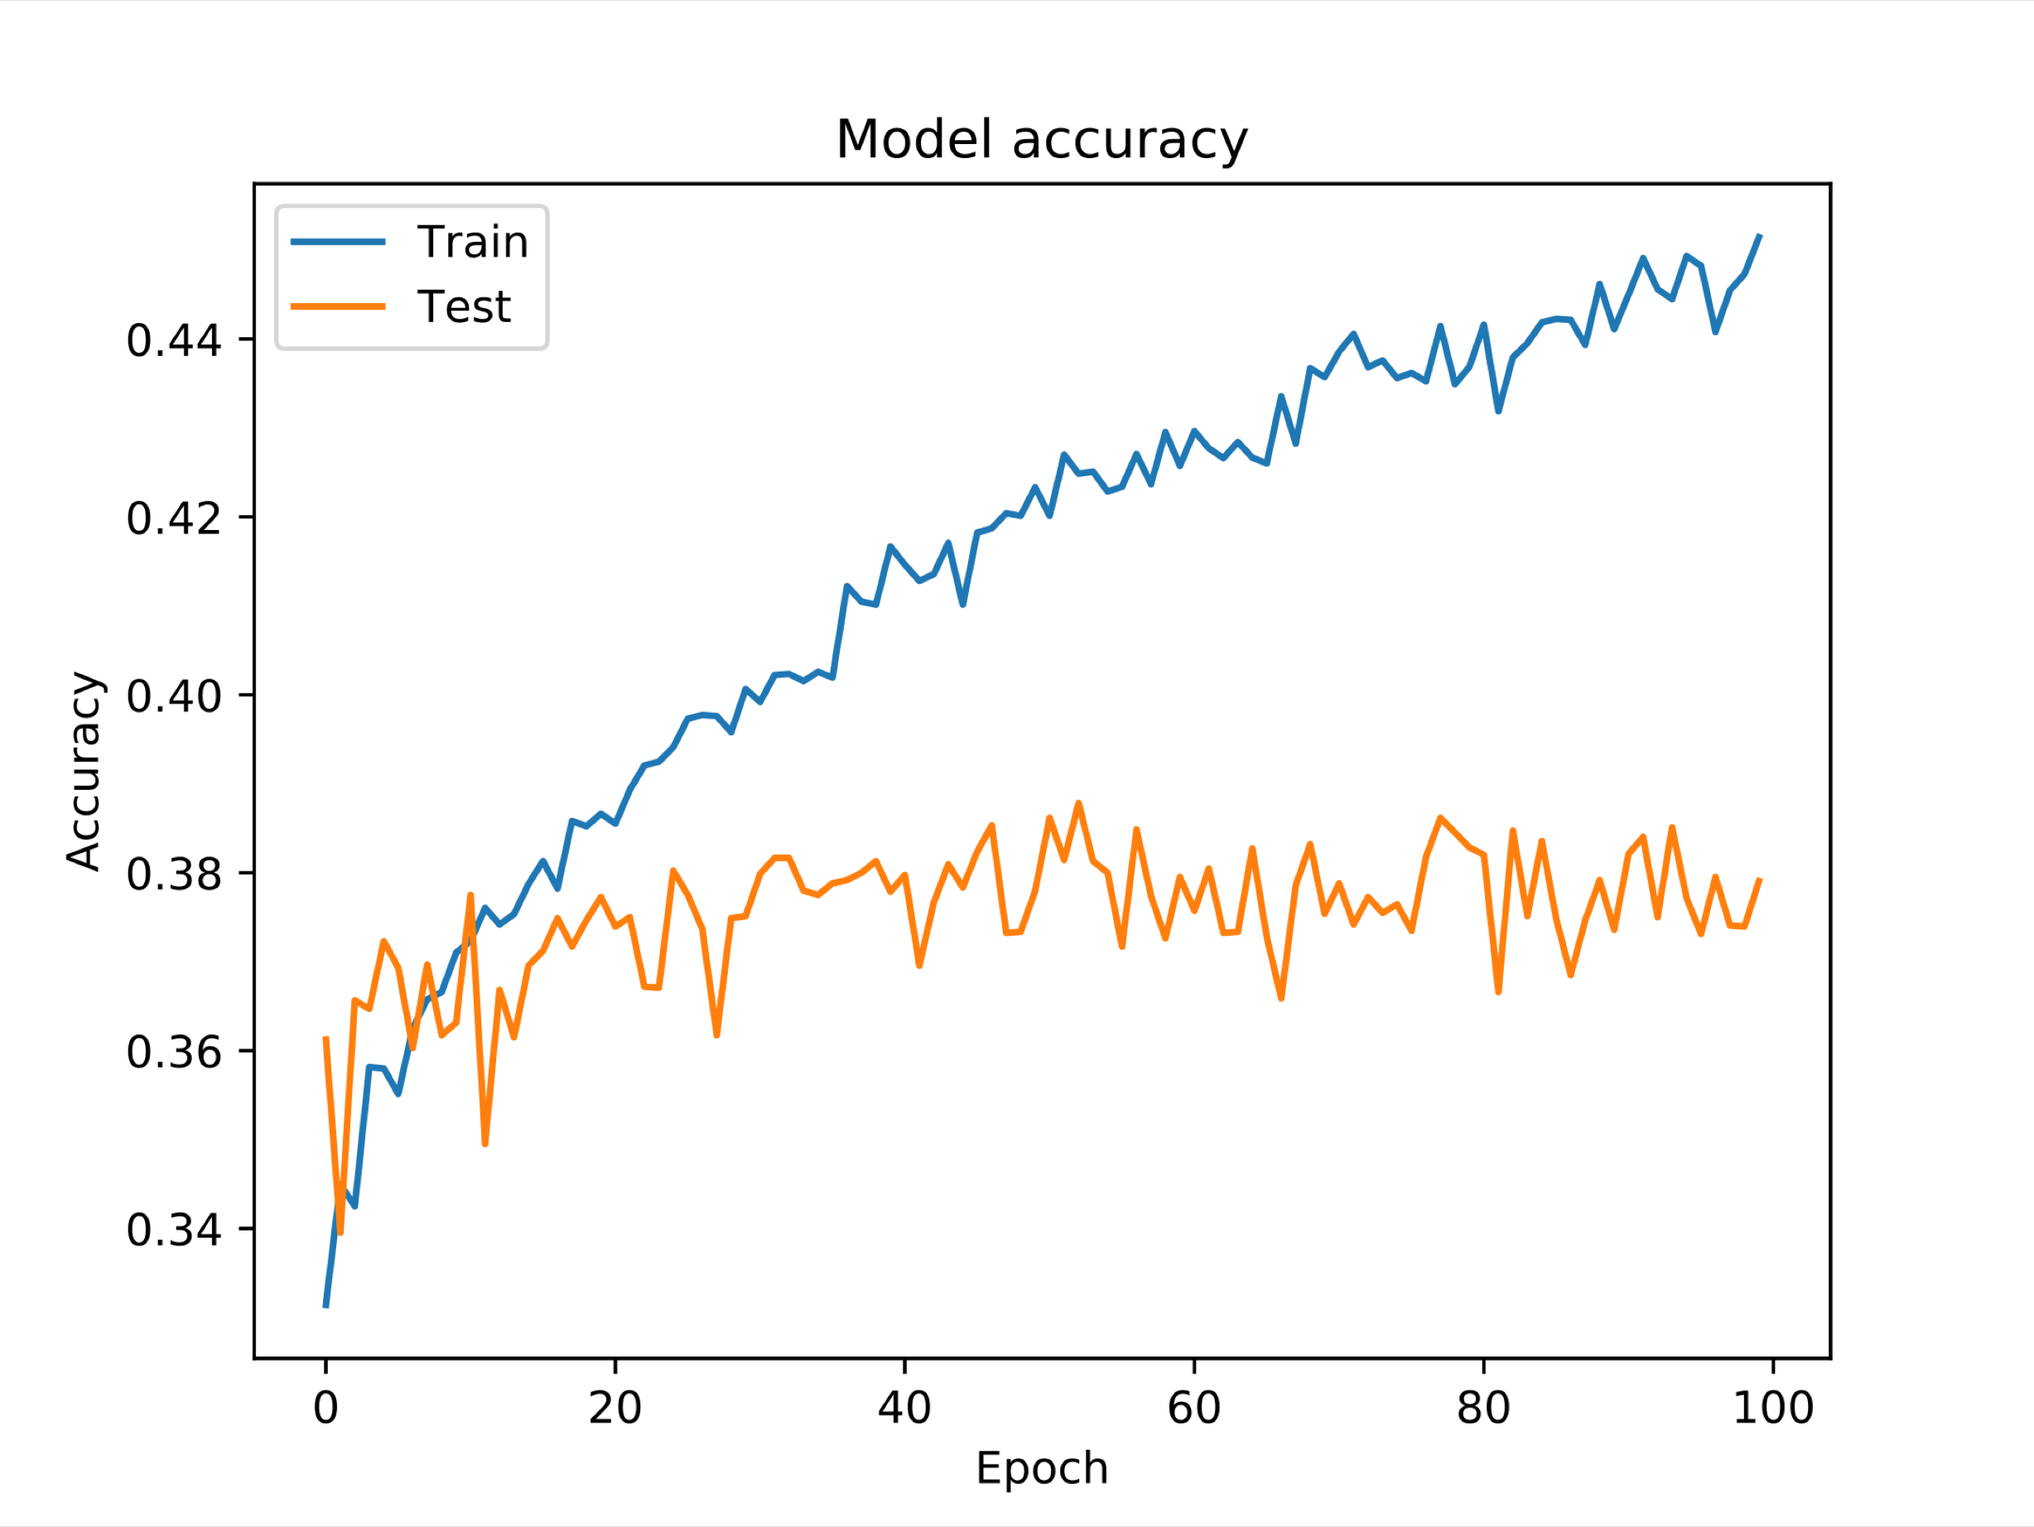
Accuracy improvement
Phoenix: no obvious change
Vancouver: 7.94% increase
Toronto: 12.14% increase
Portland: 15.45% increase
Seattle: 8.4% increase

Slide 30
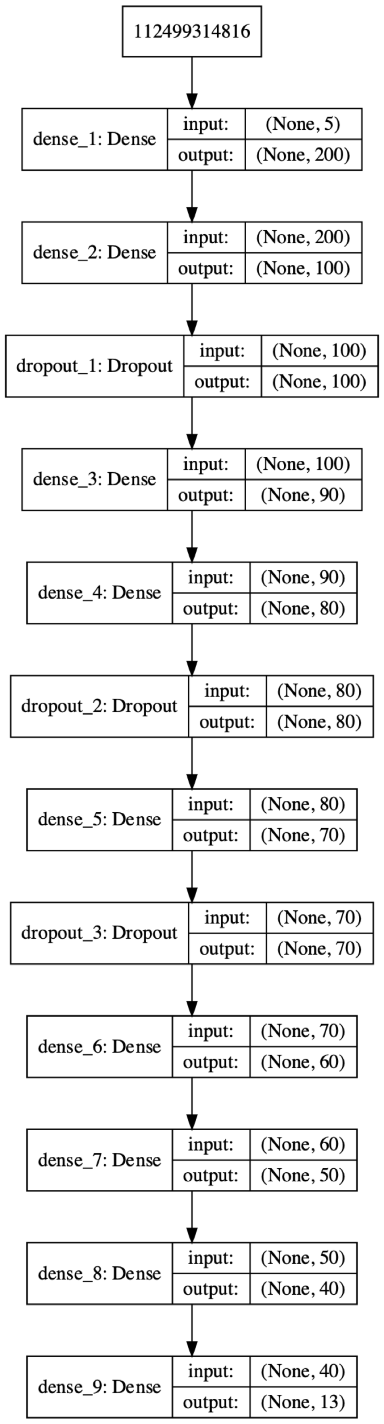
Overfitting check
Model accuracy result of Vancouver (overfit)

Slide 31
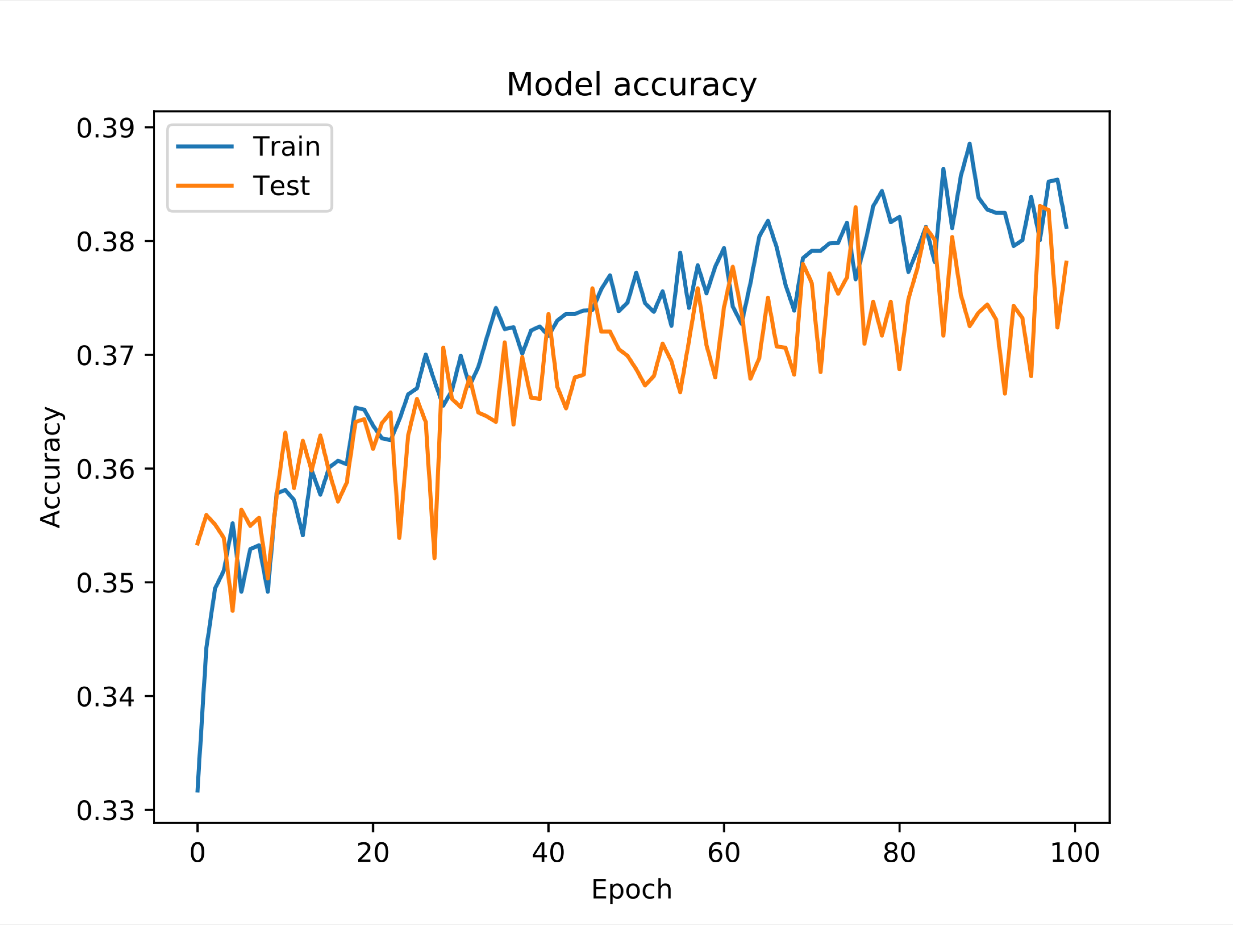
Overfitting check - optimized
Model accuracy result of Vancouver, left: before adding dropout, right: after adding dropout.

Slide 32
Forecasting Accuracy for selected North American cities

Slide 33
Thanks for your attention!

Slide 34
Backup slides: Toronto time series result, using daily data

